Slide 1
Rights enforcement: can we make a change?
Bulgarian Center for Not-for-Profit Law
Nadia Shabani, Director

Slide 2
Riga
The presentation will include:
The context
Next Step Program – tool for changing people’s life and environment
Researches
Advocacy actions
New draft Law - The New Formula
25 April
2016

Slide 3
The context
Ratified by Bulgaria in 2012 and in force from April 21, 2012 (but not the Opt Protocol)
Judgment of the Grand Chamber of the European Court of Human Rights on the case of Stanev v. Bulgaria of 17.01.2012 (appl. 36760/06), after that – Stankov v. Bulgaria – 2015 – the same findings
Council of ministers: Concept of changes in the national legislation relating to application of the standards of Article 12 CRPD (2012)
Bulgaria and the
CRPD – milestone events

Slide 4
The context
Experts’ group to evaluate the Concept (2014) – a step back: the role of the legal doctrine
Courts: dilemma how to deliver justice between CRPD and the national law
Challenging the law: Ombudsman addresses the Constitutional court
the role of the NGOs – BCNL & others
Bulgaria and the
CRPD – milestone events

Slide 5
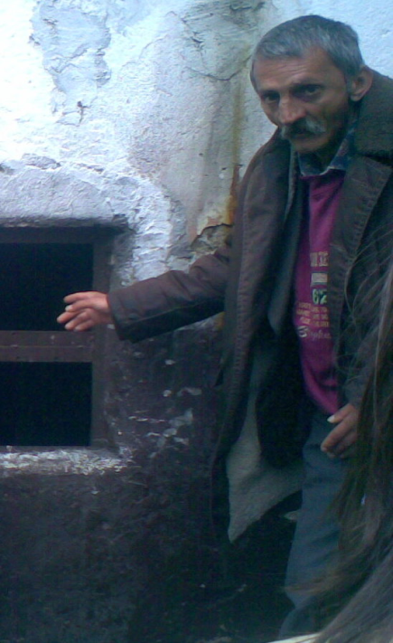
Case stanev
Deprived from liberty
“It seems clear to the
Court that if the
applicant had not been
deprived of legal capacity
on account of his mental
disorder, he would not have
been deprived of his liberty. .”
European court of human rights, grand Chamber, case of Stanev v. Bulgaria,
p. 154.
Vs. BUlgaria

Slide 6
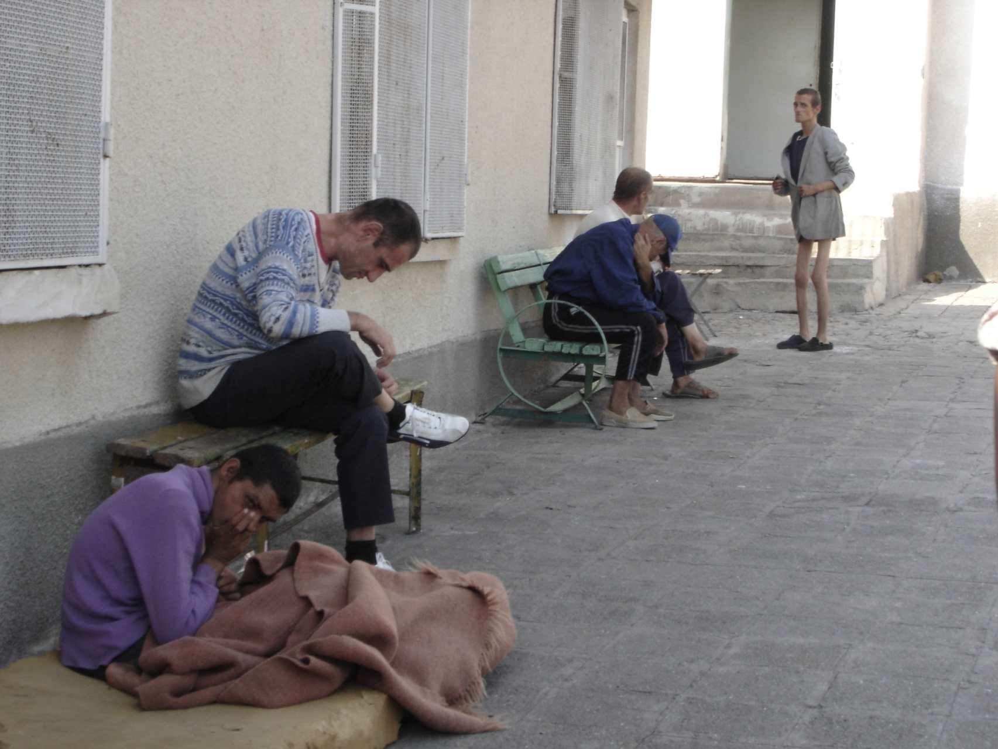

Slide 7
NEXT STEP
The Next Step Program
EXPERT SUPPORT TO THE PILOT PROJECTS
coordination of the program
trainings of the pilot project teams
RESEARCHES
cost-effectiveness study
action research
ADVOCACY AND KNOWLEDGE EXCHANGE
Elaboration of legal framework
capacity building of professionals
policy research
PUBLIC AWARENESS - RAISING
dissemination of materials
study visits
public debate
legal consultations and personal cases revision
provision of info
Program
3 projects

Slide 8
Statistics
Over 40 000 persons with mental disabilities (7 300 000 – population BG)
Around 80 00 persons with psychosocial disorder
Around 7 000 persons are legally incapacitated – under full/partial guardianship
85% of adults placed in care institutions are incapacitated - open door to restrict the personal freedom & choice
Guardianship serves to replace the missing personal care for adults
Inability of close community/family to provide care turns to waiving of legal capacity (to act)
Article 12 CRPD

Slide 9
Pilot program
For whom: people excluded from the community as a result of intellectual disability and/or a mental health problem – people considered (by someone) incapable of making decisions, working, etc. throughout their entire lives or in certain periods (e.g. in a period of a mental crisis).
Decisions:
For SDM

Slide 10
Everyone, regardless of whether he/she has disability and how serious it is, has desires, preferences and will;
Desires, preferences and will should always be recognized and respected, regardless of the problems in communication;
Everyone, regardless of whether he/she has a disability is able to build relationships of trust with another person;
Everyone, regardless of whether he/she has disability, at some point needs support in making decisions and receives it from people whom he/she trusts.
Hypotheses

Slide 11
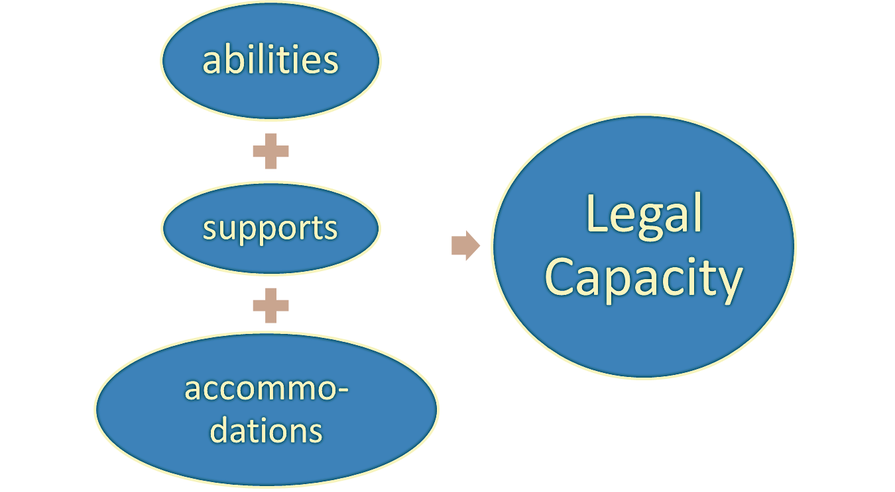
The new formula:
How:
8 locations
80 people

Slide 12
researches
Action research - study and promotion of change in groups;
“The new formula” – legal proposals based on the grassroots experience;
Policy research – how to shape public policies
Guidelines for SDM: a tool how to exercise rights!
Cost-benefit analysis
Legal articles
Regulatory Impact assessment - ongoing
The pilot program for SDM: is it possible to learn?

Slide 13
Cost-benefit analysis
First attempt to provide evidence that SDM as alternative to guardianship system is beneficial to both the persons with ID and MHP and the society not only in terms of non-monetized effect – increased QL and consistency win UNCRPD, but also from merely economic perspective
effects of SDM mechanisms on the quality of life of people with MHP and ID;
potential financial costs and benefits for the society of SDM vs. guardianship;
concludes on the answer on the basic question set at the beginning of the analysis - do the benefits of SDM exceed the costs?

Slide 14
Cost-benefit analysis

Slide 15
Cost-benefit analysis

Slide 16
Cost-benefit analysis
CONCLUSIONS:
The answer on the basic question is YES.
SDM contributes to persons with MHP and ID’ inclusion in the society and improvement of their employment opportunities. Increase of annual person’s income with 1 630 euro (59%); annual saving for the society of 2 506 euro per person (66%).
The non-monetized benefits that have much bigger value. Quality of life, respect for human rights, independent living and inclusion in the community for people with ID and MHP are “priceless” benefits that give the strongest argument to policy makers.
do the benefits of SDM exceed the costs?

Slide 17
CHALLENGES
Challenges:
Political turbulence
Political & gov. crisis starting from the summer of 2013.
Huge resistance from legal doctrine
- Stands behind the current ‘paternalistic ideology’ of
the law that results in exclusion & discrimination;
questions the interpretation of the values and the provisions of article 12 and their application;
questions the existence of will & preferences of persons with intellectual and psychosocial impairments.
Pilot programme implementation has to compensate the lack of development in the systems - the implementation of the measures for SDM shall to upgrade rather than compensate the required conditions in system delivery of services (healthcare, education and social care).
Challenges

Slide 18
Physical persons and measures for support Act – draft for public discussion
Paradigm shift - challenging the traditional concept for legal capacity
Abolition of substitute decision making (guardianship),
Right to enjoy the personal rights (family life, associate, testate) personal support;
Trustee relationship – proving tool
New draft proposals

Slide 19
The principle: people with disabilities can decide by their own about their rights
The exclusion: for some particular cases persons with disabilities may need support and help to make their choice
The prohibition: nobody can take decisions instead of a person, will and preferences shall always be recognized.
The “new formula” – supported decision making…

Slide 20
The support measures – different possibilities for the court
Limited (concrete) areas of support
Alternative communication is not a restriction
“Best interest” vs. will and preferences
The principles as safeguards
CSO new role

Slide 21
SM is a system of measures aimed at ensuring that the person grasps the information, assimilates it, makes the decision and communicates it.
SDM:
Advance directive and Power of attorney
SDM agreement
Co-decision making arrangements
Facilitation procedure for re-action in risk

Slide 22
The real new formula
abilities
Decision-making capability to make decisions to live in the community
supports
reasonable accommodation
legal status

Slide 23
BG law | The new draft law
Equal recognition before the law (capacity to have rights / legal standing) ex lege - | Equal recognition before the law - legal capacity = to hold rights and to exercise rights simply by virtue of being human - art. 12 /1,2 Capacity to act – legal agency - support for the individual autonomy art. 12 /1, 2, 3: Supported decision making
Capacity to act – prerequisites: age + will and consciousness Reasonable & rational person has the capacity to act = Substitute decision making
The principle “Best interest” | The principle “recognition of will and preferences”
Protection – at 3 levels (outcome approach) Focus on property not on the person | Presumption of will and capacity to act = respect the rights, will and preferences of the person
Equality before the law ?

Slide 24
On focus
“INCLUDED, but NOT EXCLUDED”
“I DECIDE=I AM”

Slide 25
THANK YOU!
www.bcnl.org
/analyses
nadya@bcnl.org

